Slide 1
Your Adventure Awaits
with Sail Training International

Slide 2
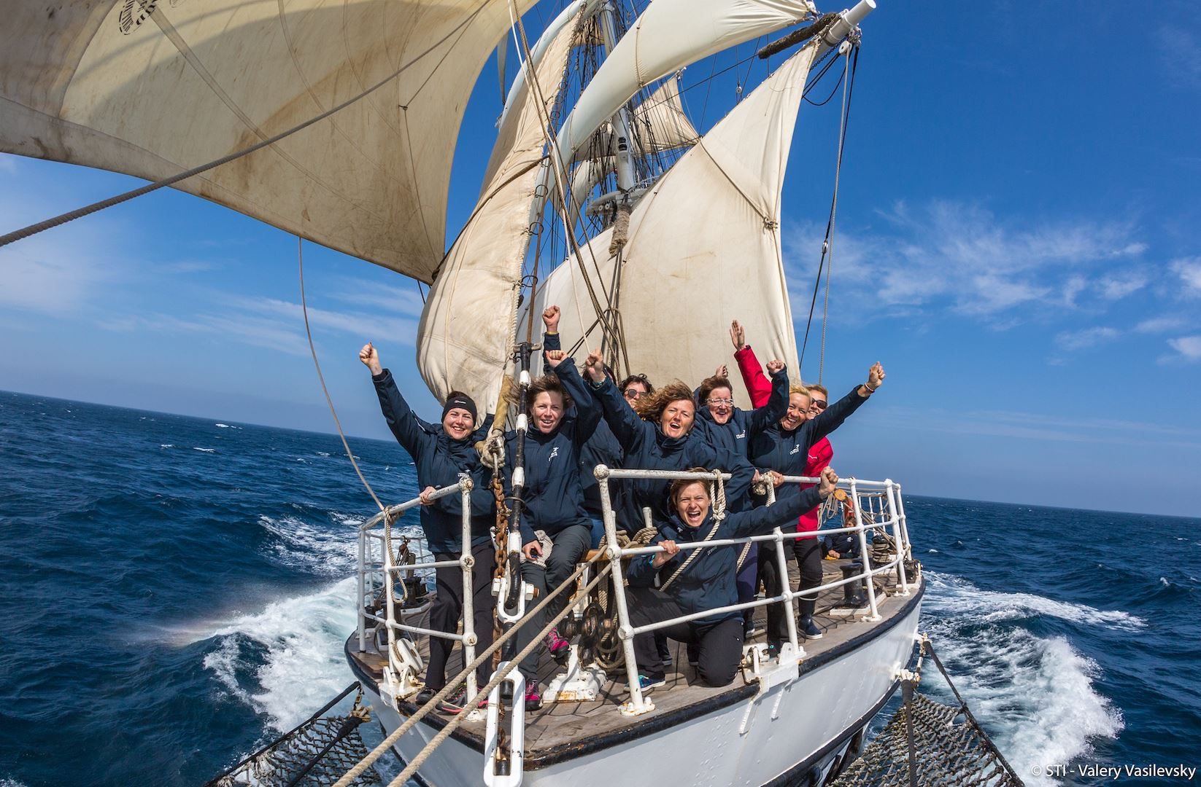
Sail Training International
An international charitable organisation who provide experiential learning through sail training.
We offer life changing experiences for young people aged 15-25 around the world, helping them to grow in confidence, discover who they are, unlock hidden strengths, rise to challenges, overcome fears and enjoy the adventure of a lifetime.
Sail Training International is the international voice of sail training and a global, Nobel Peace Prize nominee.

Slide 3
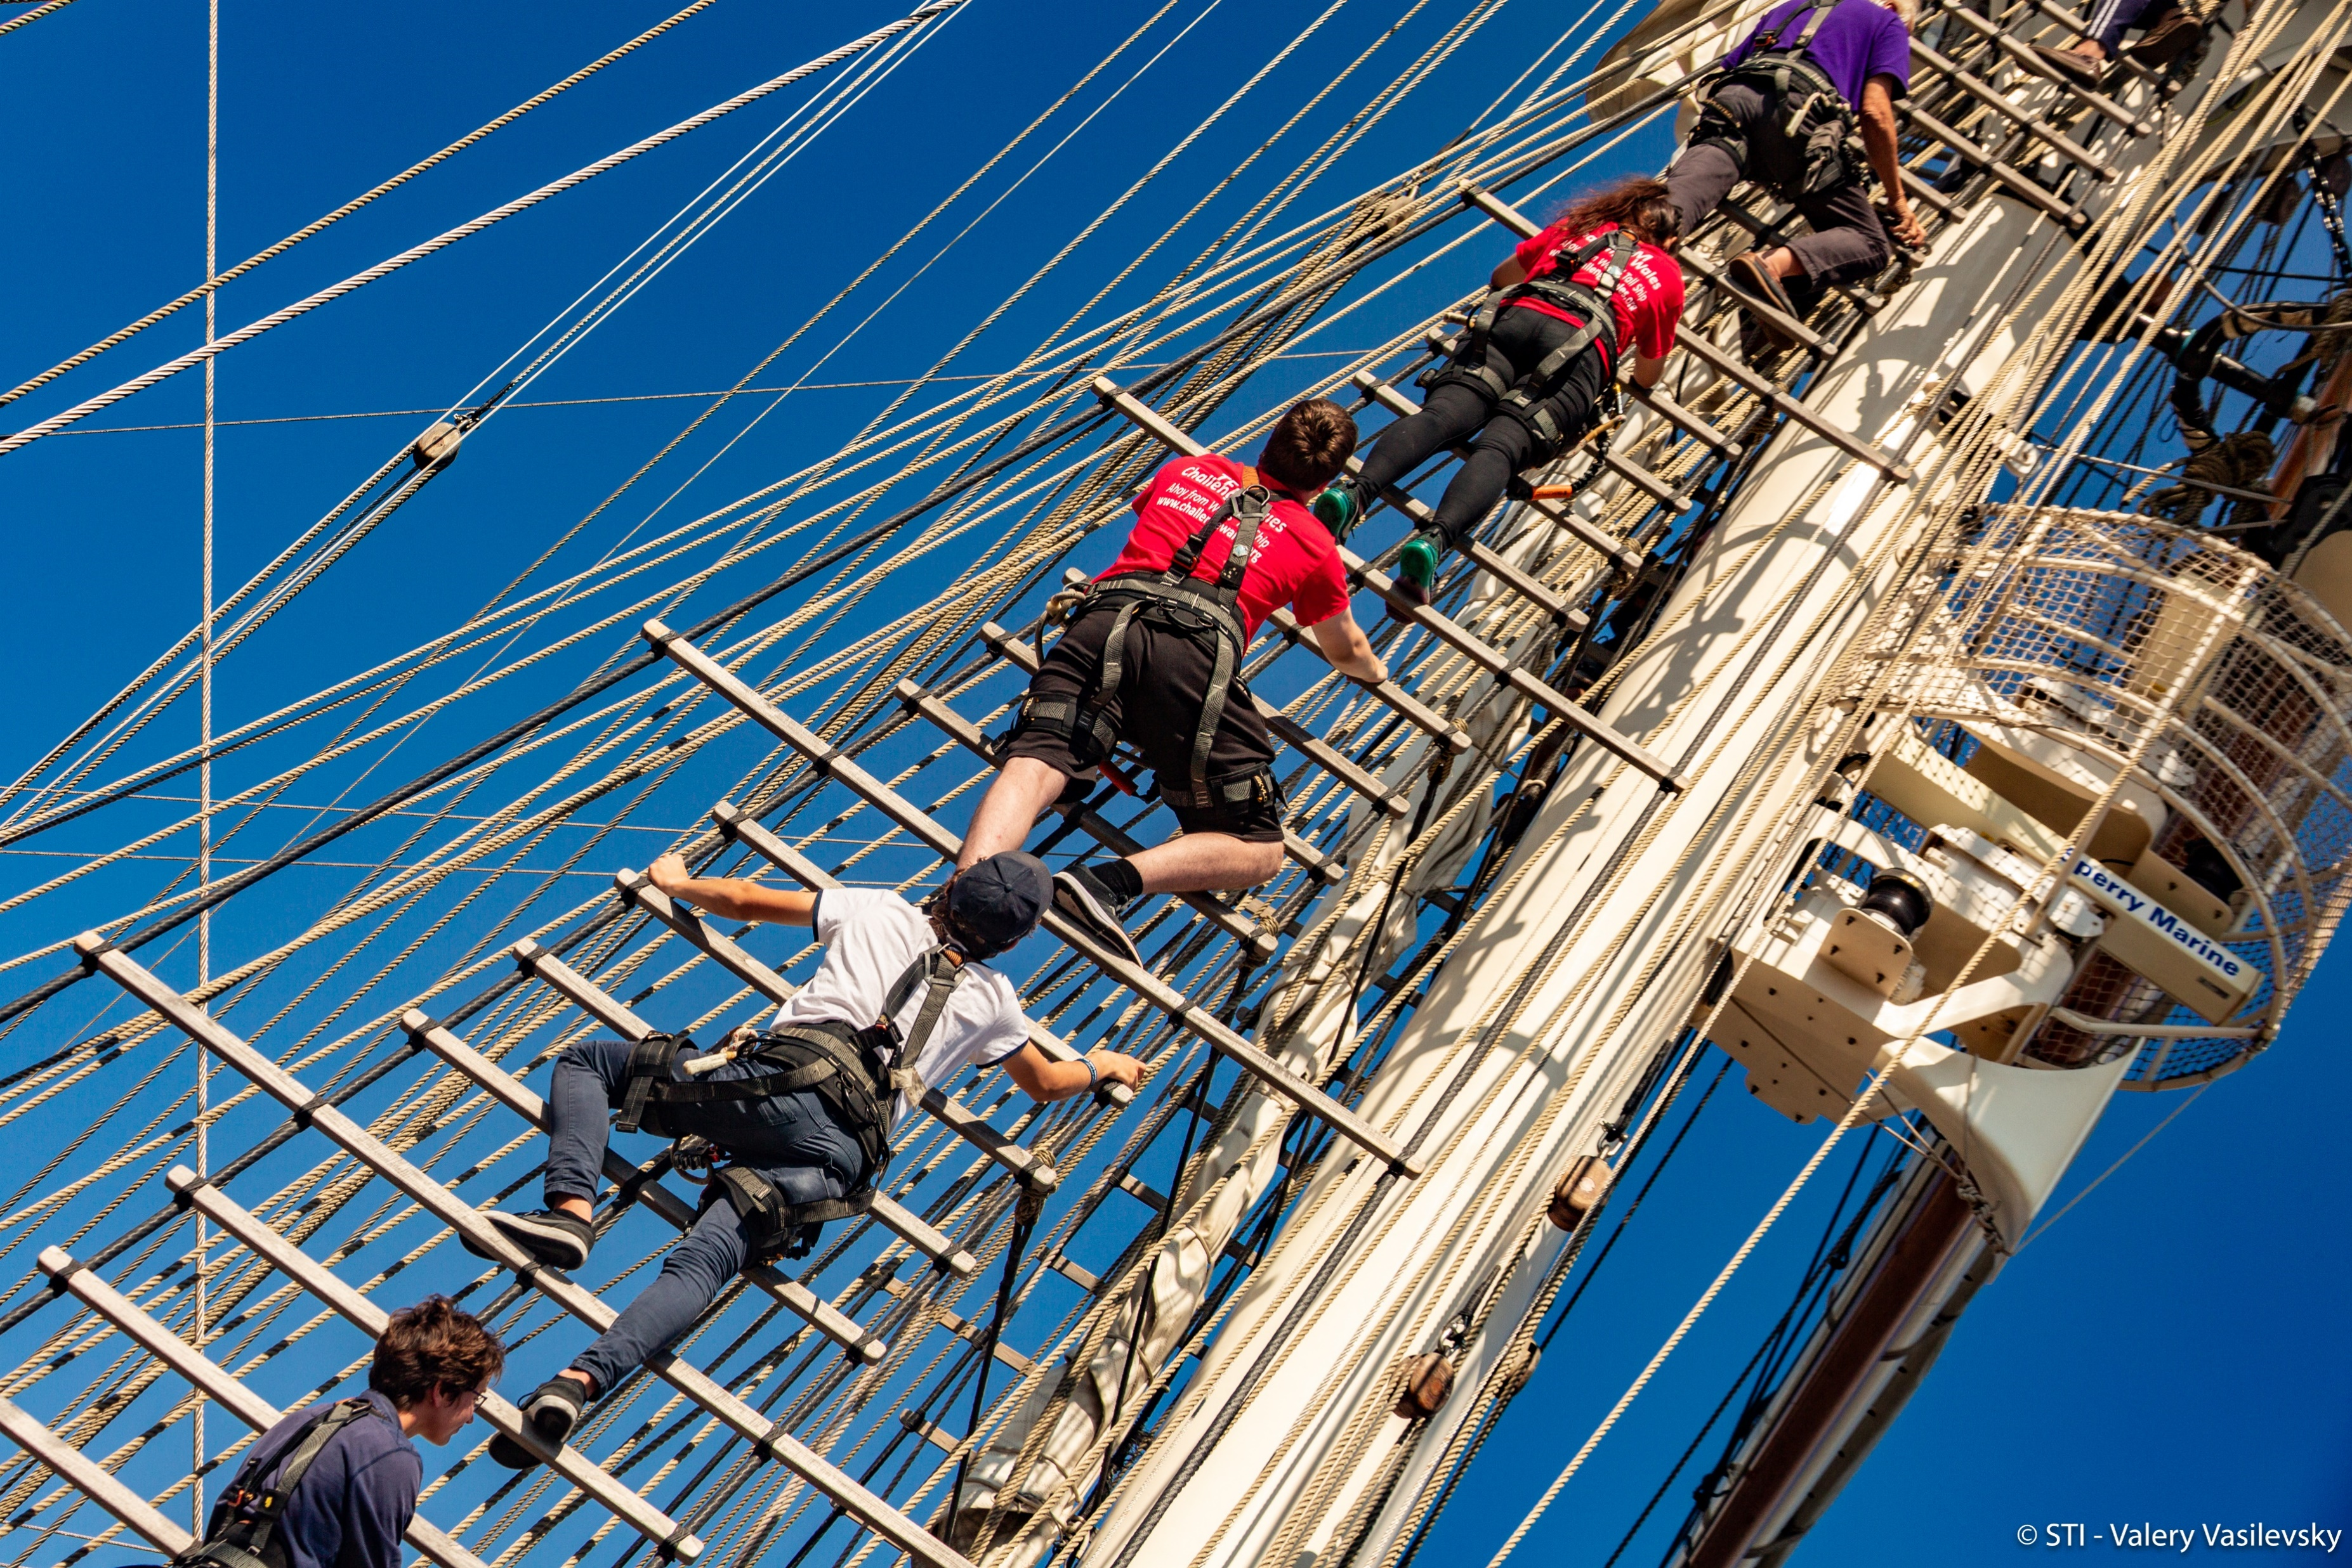
What is Sail Training?
- An exciting, fun and life-changing outdoor sailing adventure.
- A hands-on sailing experience learning about every role on board.
- Working as part of an inclusive and enthusiastic team, which includes people of all ages, nationalities and abilities.
NO PREVIOUS SAILING EXPERIENCE IS NEEDED

Slide 4


Slide 5
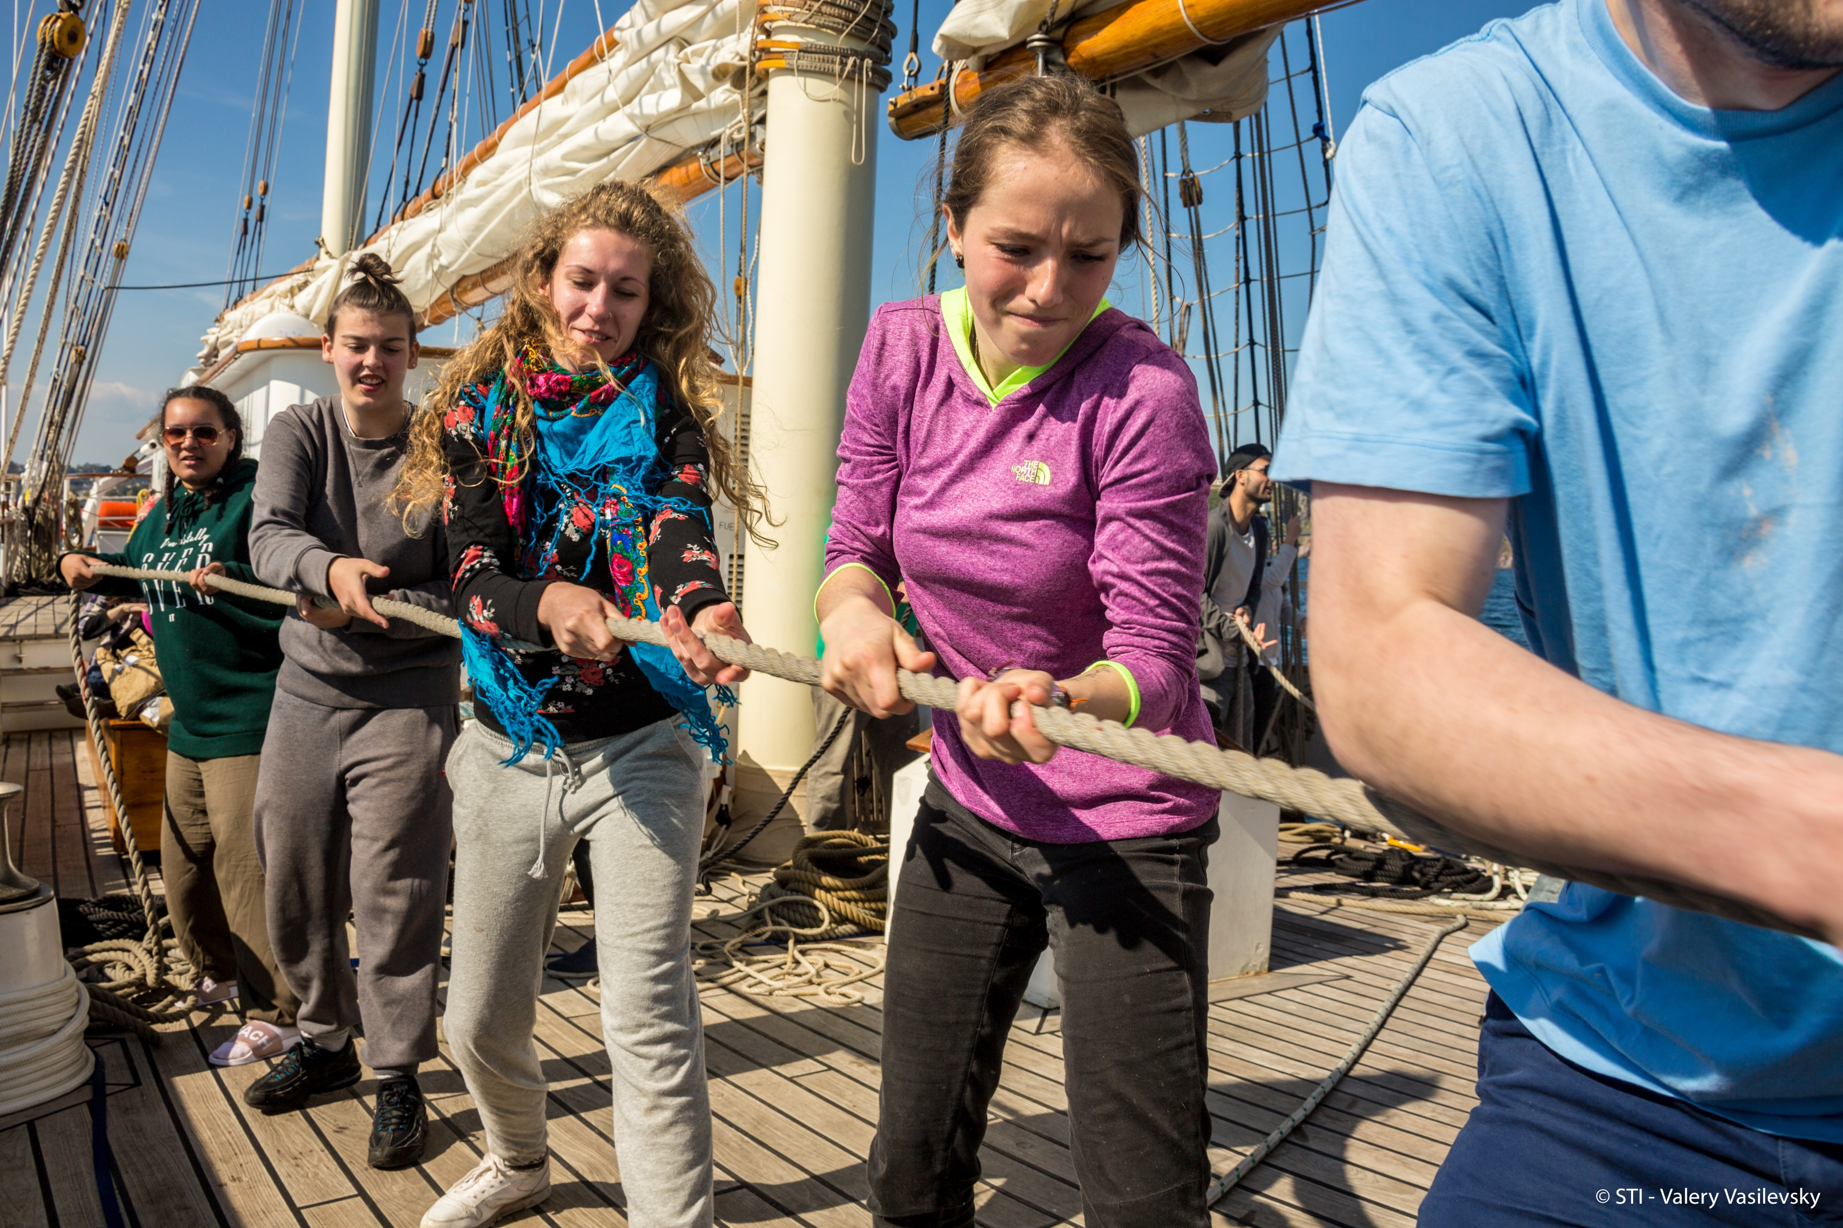
Life Onboard
What to expect
EQUAL OPPORTUNITIES
Sailing is a great leveler. It doesn’t
distinguish between social status, gender
and ethnicity.
A MULTI-CULTURAL ENVIRONMENT
You will make lifelong friends from all different
backgrounds.
CREW HIERACHY
Every vessel has a chain of command. Understanding this will help with team integration.
EXPECT THE UNEXPECTED

Slide 6
Life Onboard
Roles and Responsibilities
- Watch duty (2-4hours)
- Cleaning the decks
- Maintenance – sanding/rigging/painting
- Sailing – steering/line handling/ climbing the mast/
hoisting the sails
- Navigation – Charting/plotting/making
weather observations

Slide 7
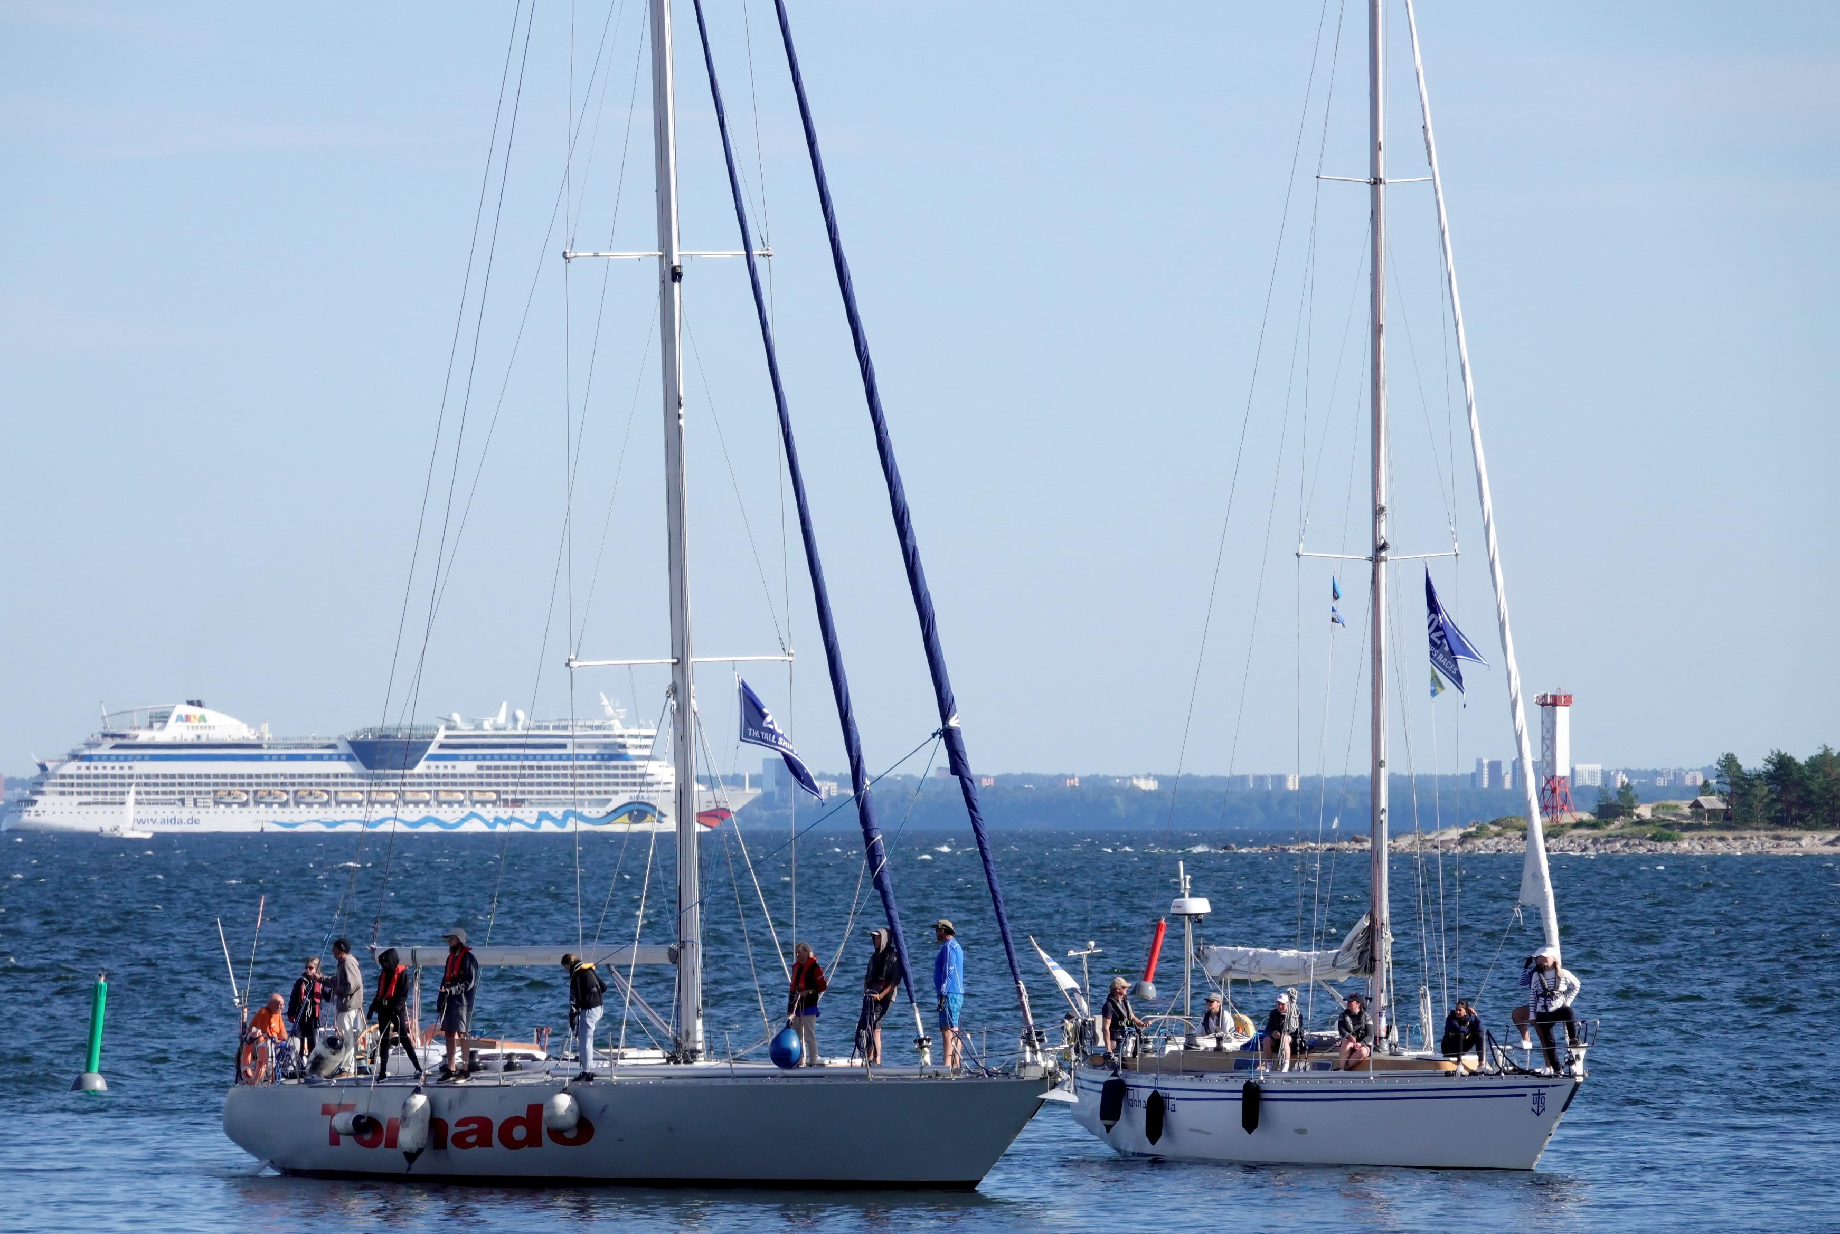
What are the Benefits?
STRENGTHEN YOUR CV - A fantastic experience
that will set you apart from the rest, when writing
your university personal statement.
BUILDS CONFIDENCE – Through social
interaction, communication and self-esteem.
INCREASES RESILIENCE – By adapting to ever-changing circumstances, working under pressure to problem solve and facing your fears.
TEAMWORK – Recognising the strength and skill-set of each team member to collectively overcome challenges.

Slide 8
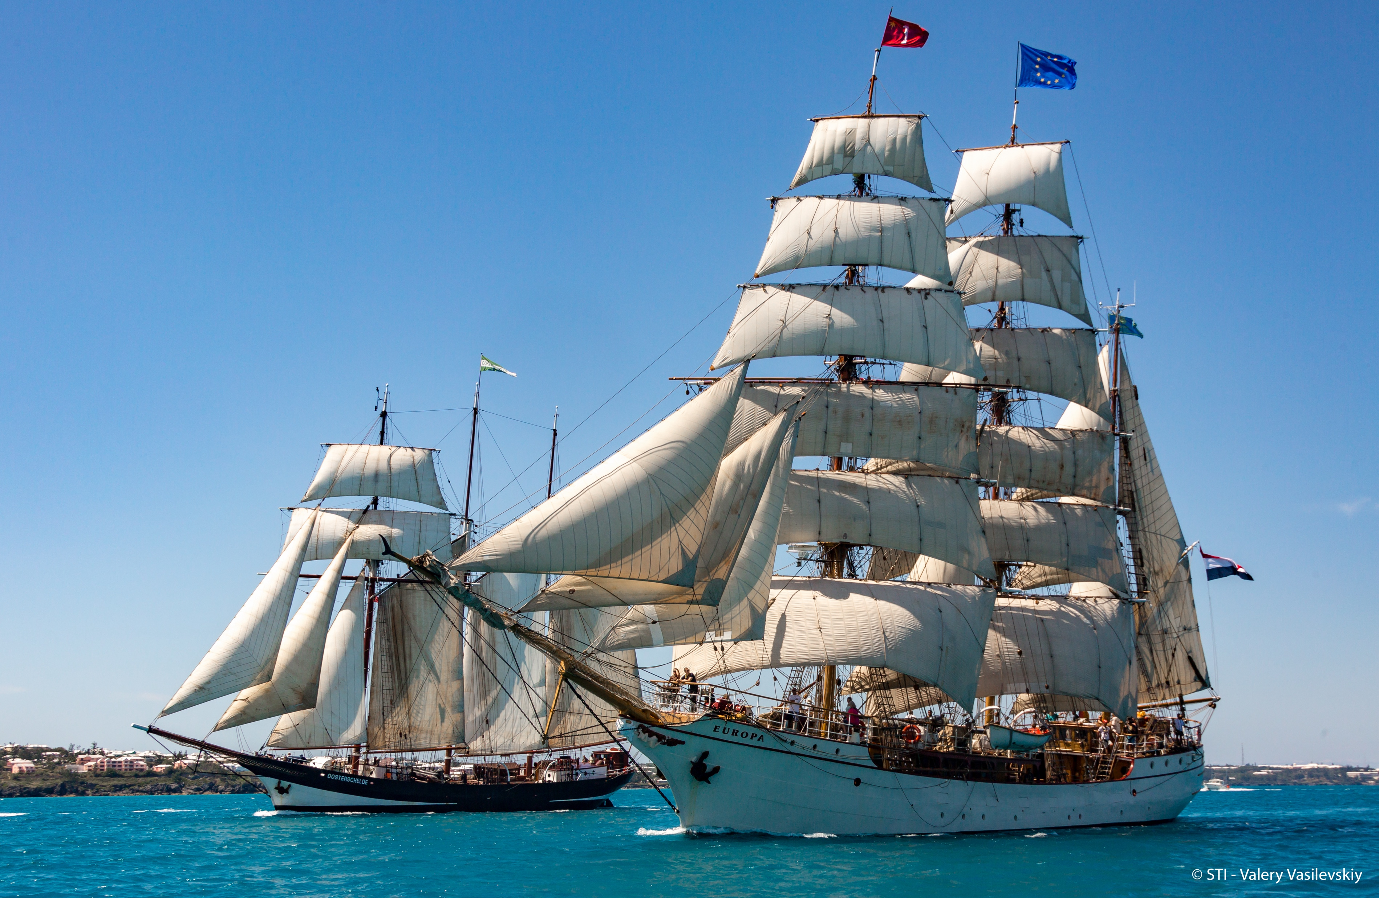

What happens when the ships are in port
Ship Arrivals
Crew Parade

Slide 9
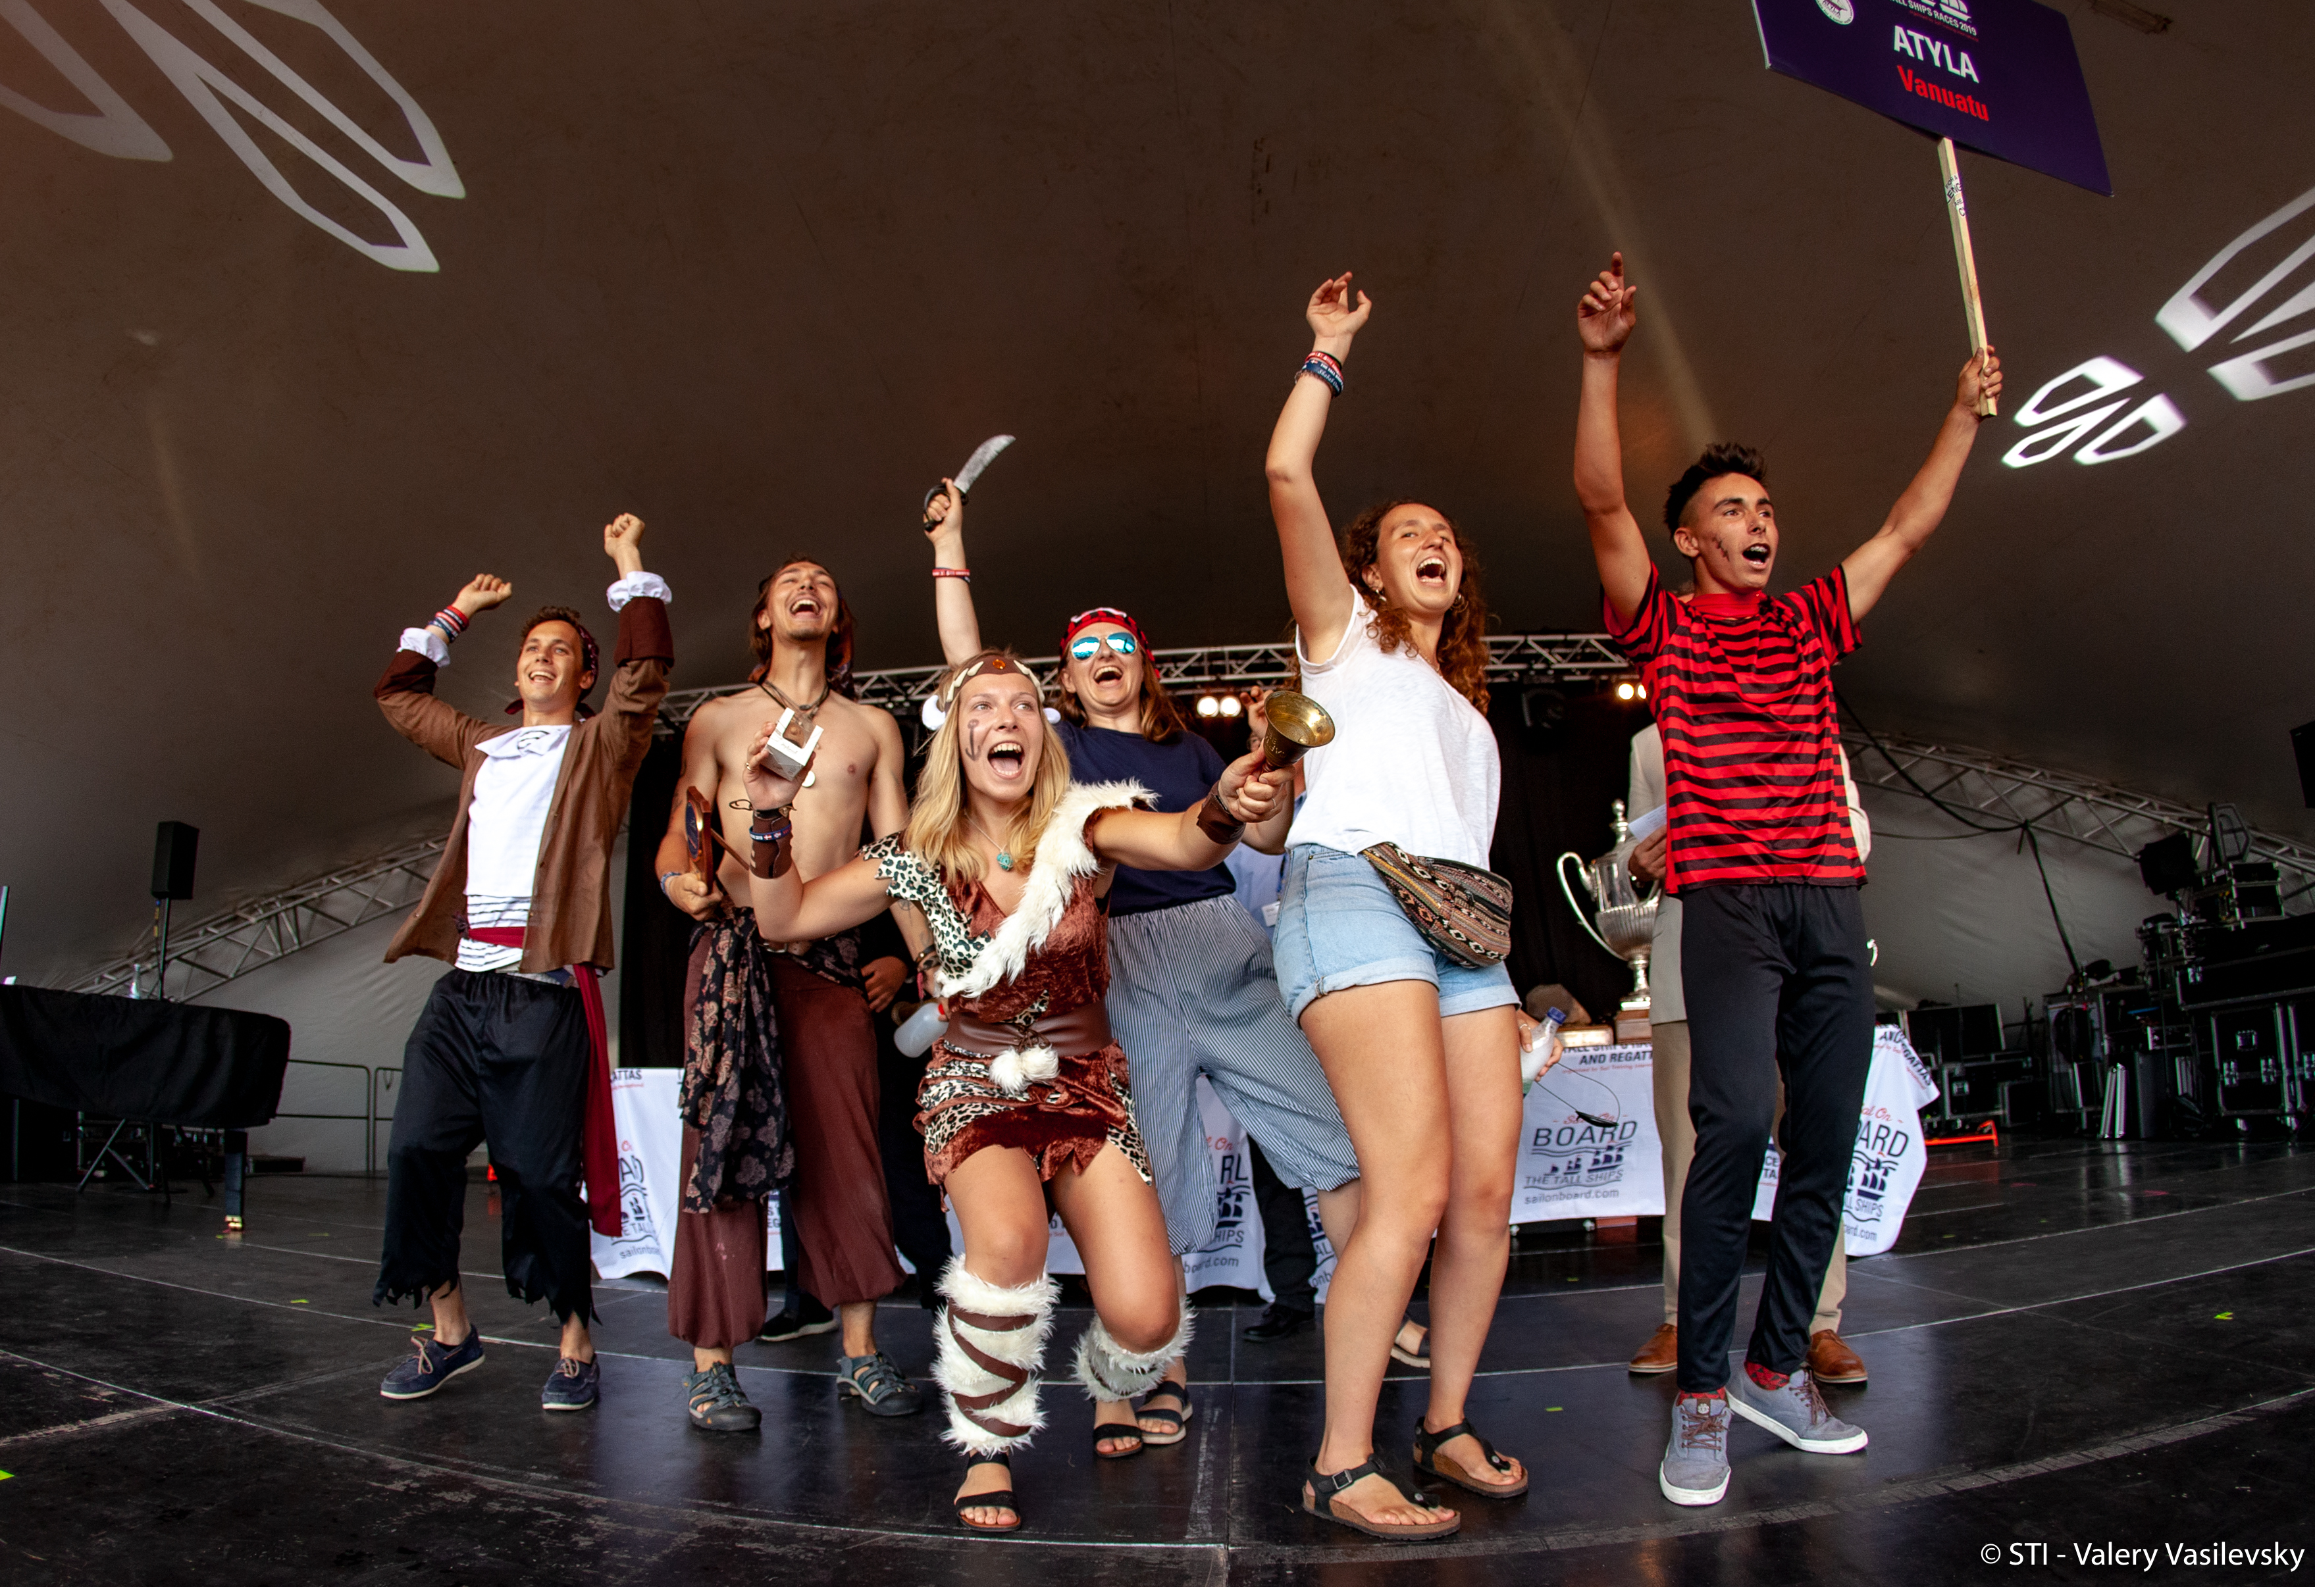
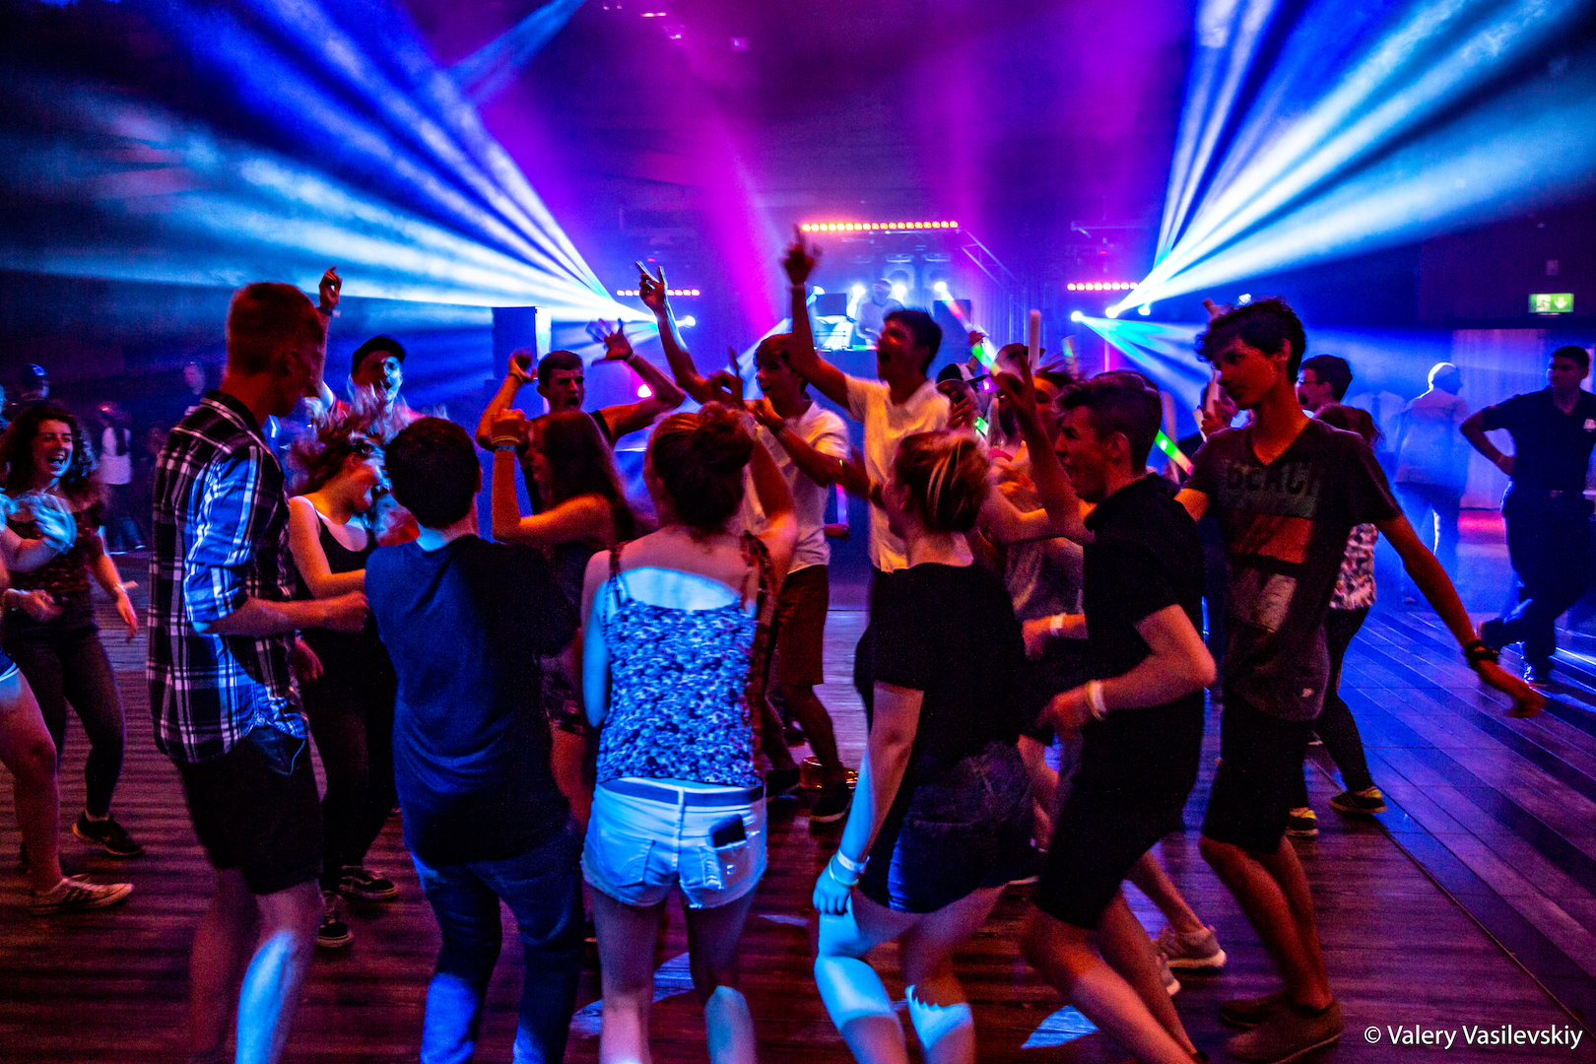
Host Port Activities
Prize Giving
Crew Party

Slide 10
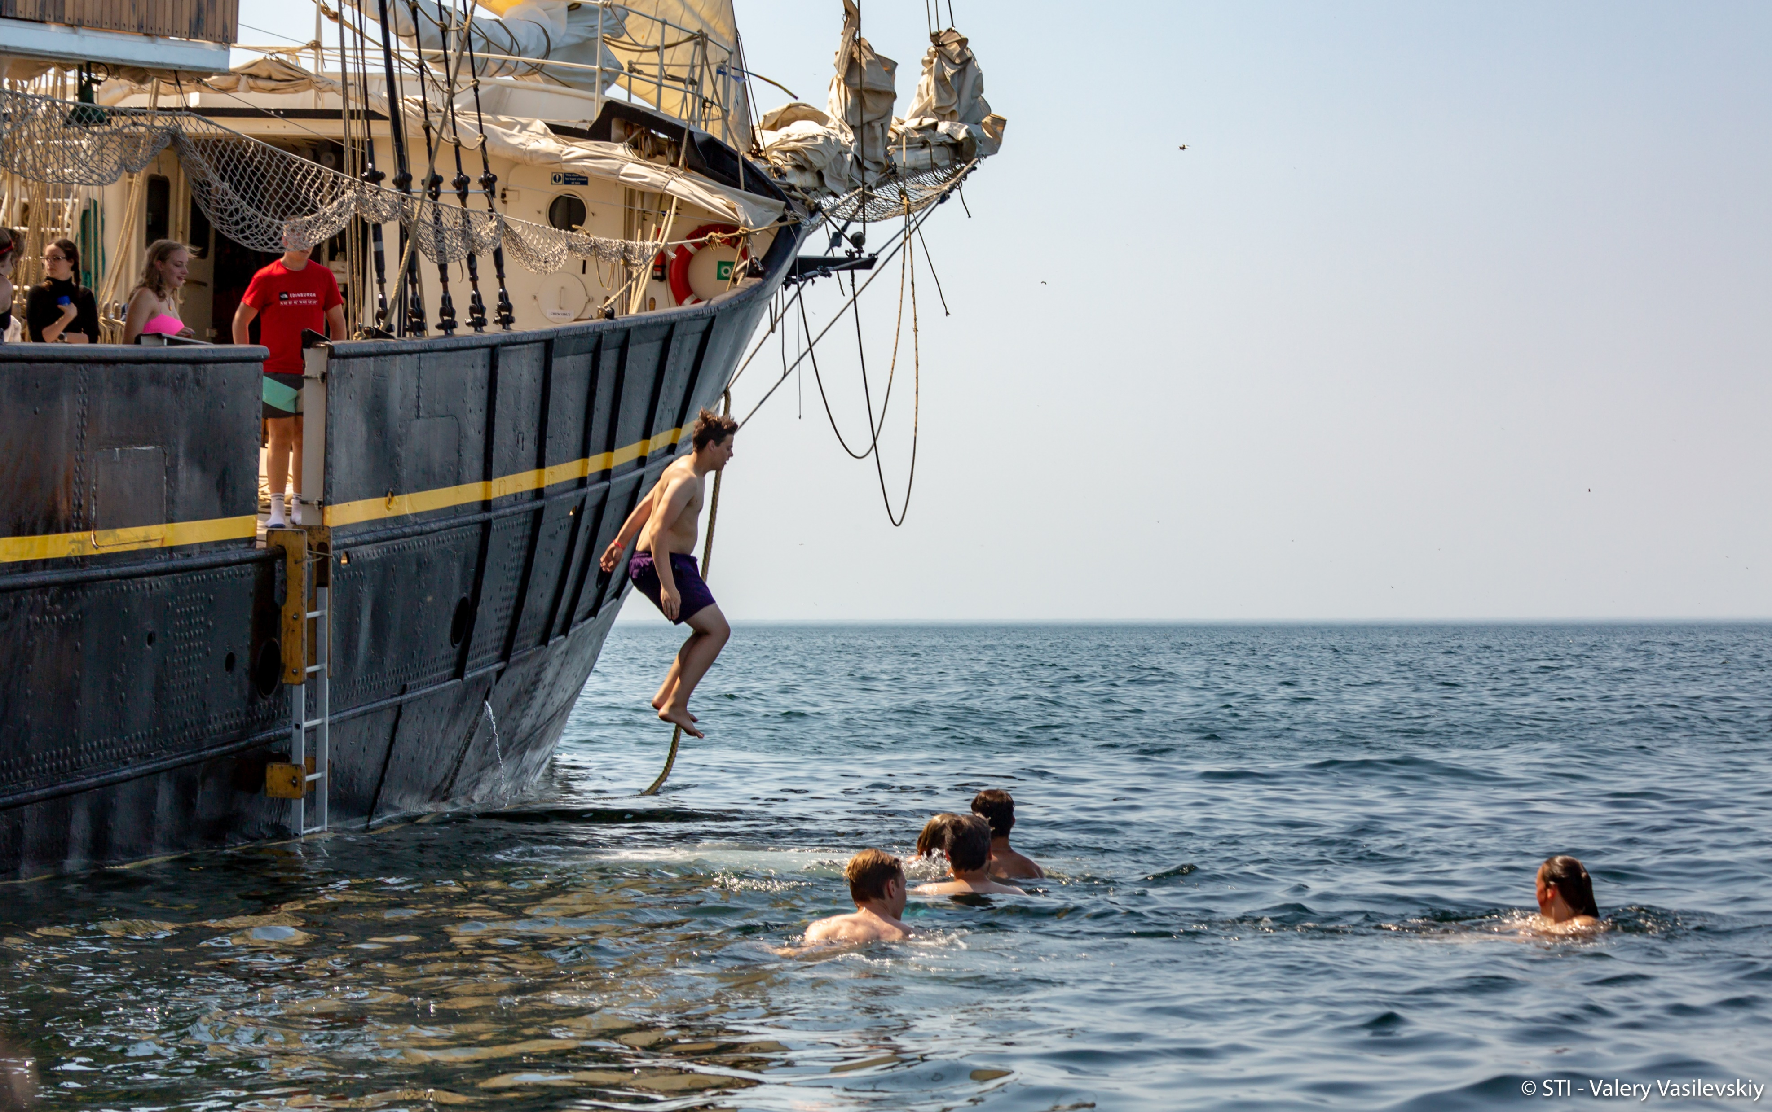
Cruise-In-Company
The chance for you to visit some smaller
ports and experience what a sea region
has to offer.
There will be port stop-overs where crews
are greeted with events and festivities.
Opportunities to experience life on board and the
thrill of sailing, without the pressures of racing.
- The opportunity to meet and socialise with crews
from other participating ships in a more relaxed
environment.

Slide 11
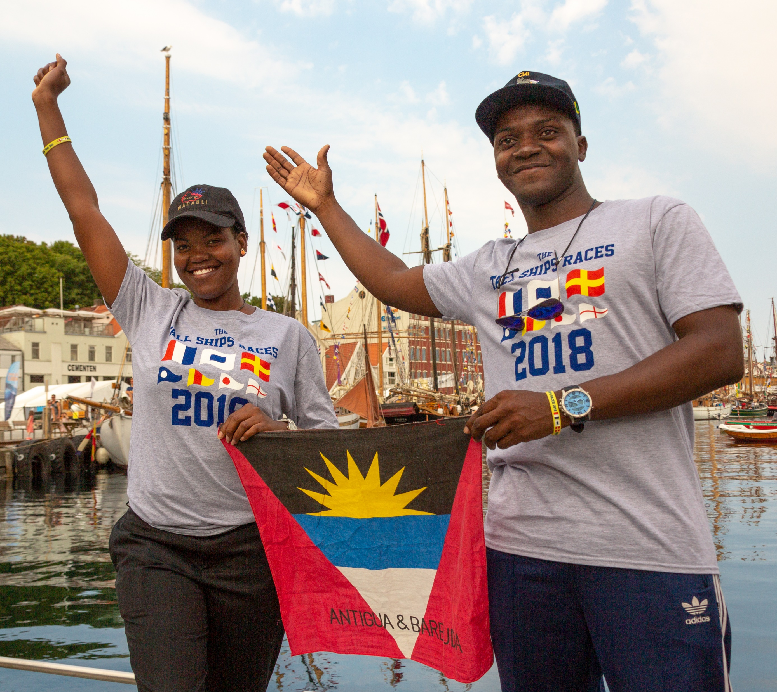
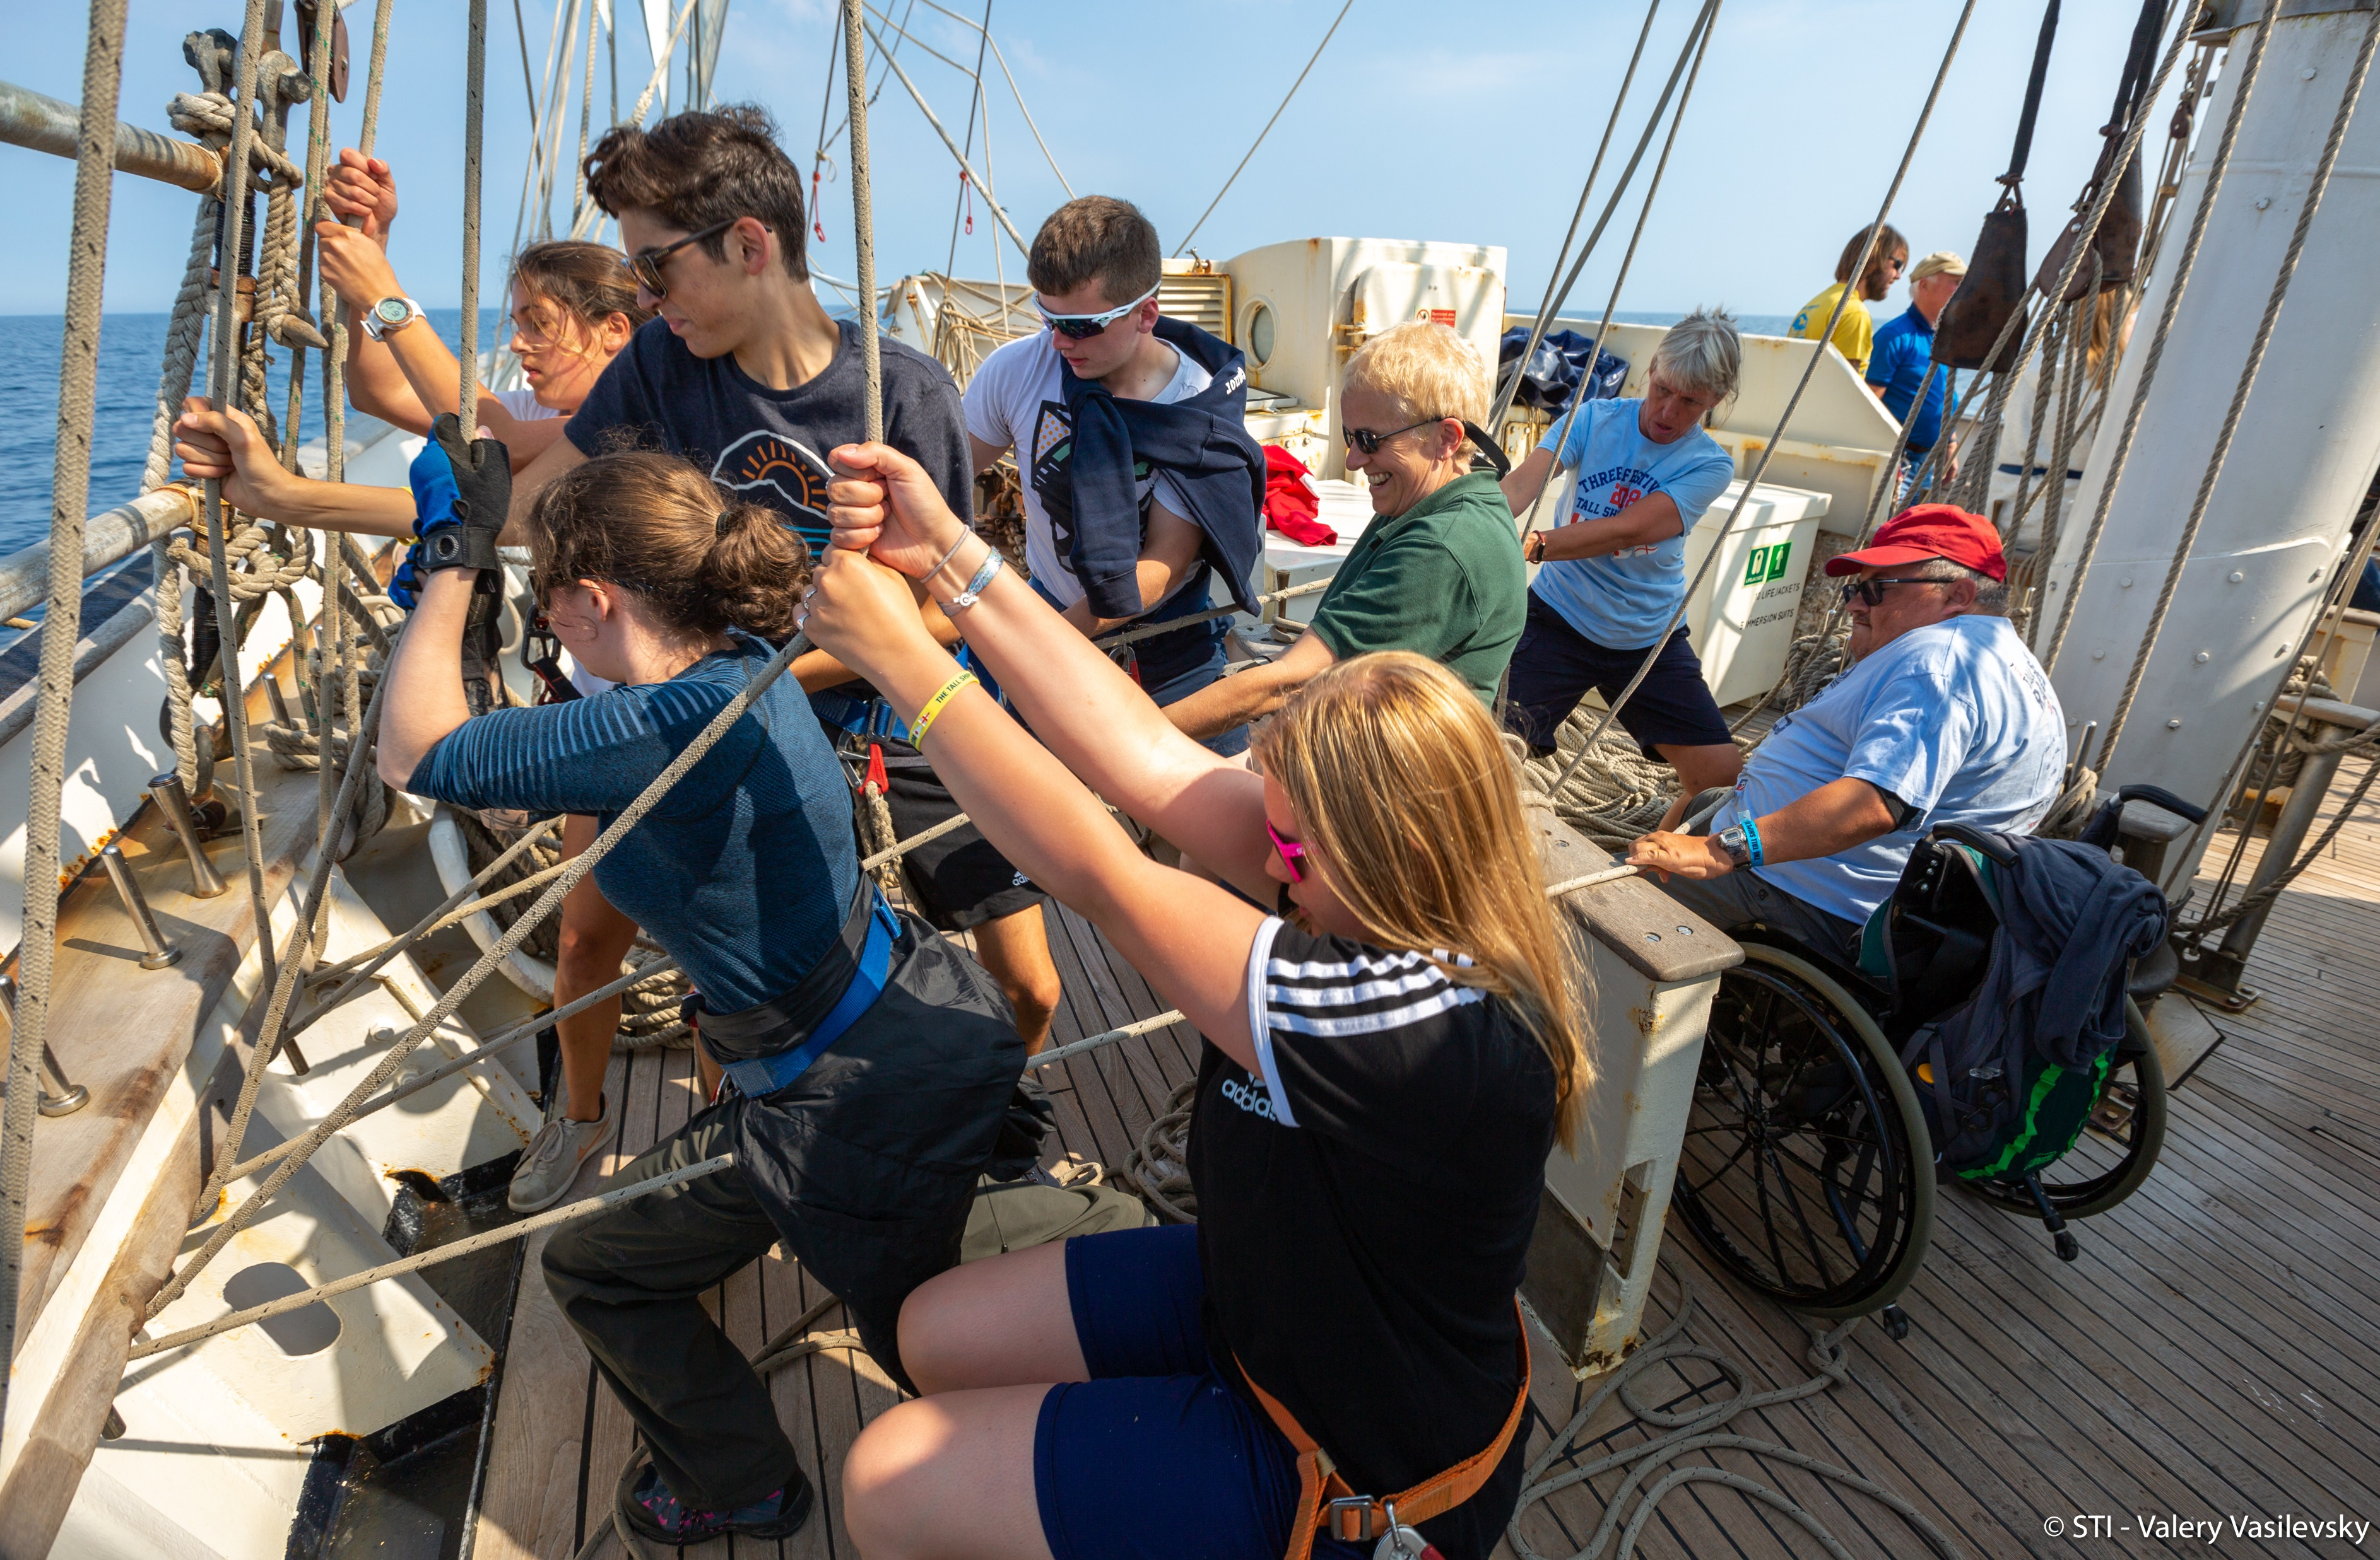

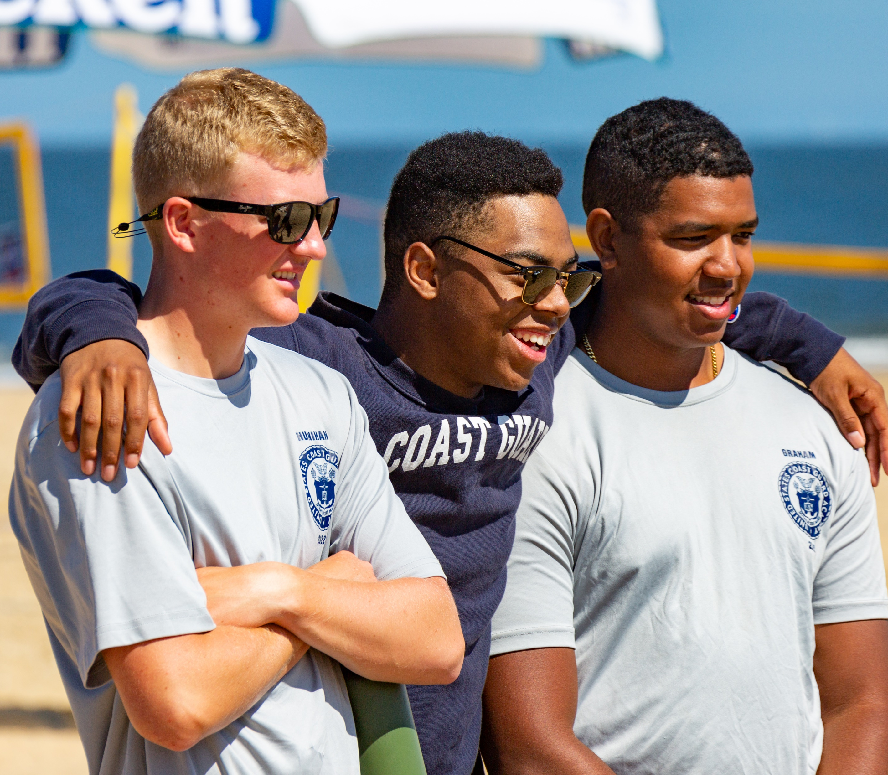

SAIL TRAINING IS A LIFE CHANGING EXPERIENCE
“For me, the most valuable
lesson I learnt was
teamwork and the ability to form a close-knit and
effective team from a group of people who were
previously strangers”.
"I will cherish the experience and new friends for the rest of my life”.
FAMILY AUDIENCE
Ethel Rosenfeldt
Charlotte, 15
“It’s a once in a lifetime experience. I think everyone should participate because it gave me a different perspective on life. Life on board is so different, but amazing!!”.
“It’s like nothing else I have ever experienced. You learn a lot, but you also learn about yourself more”.
Helen Crissen, 25

Slide 12
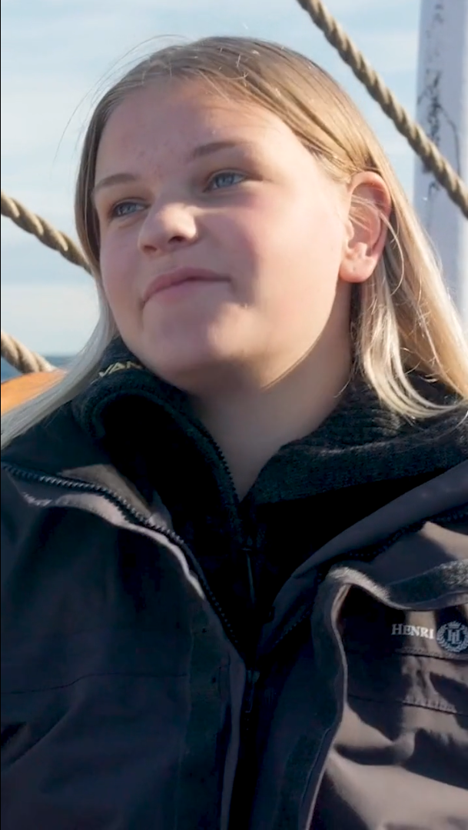

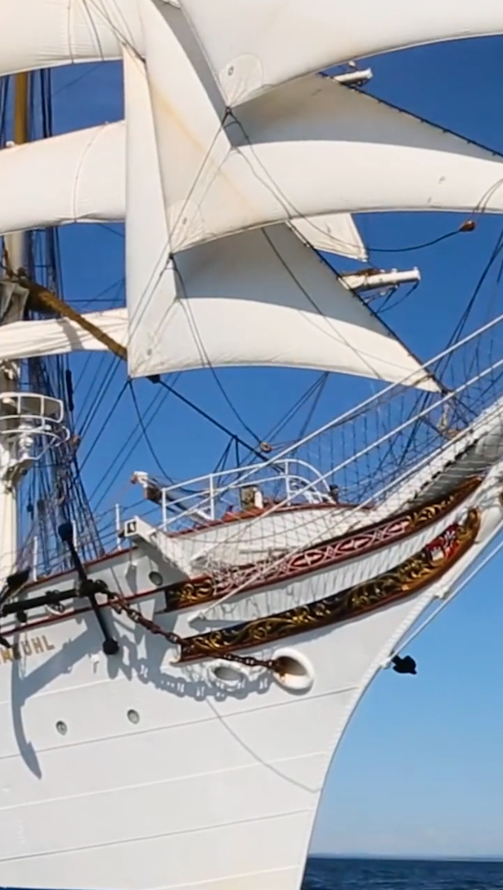
SAIL TRAINING IS A LIFE CHANGING EXPERIENCE
FAMILY AUDIENCE

Slide 13
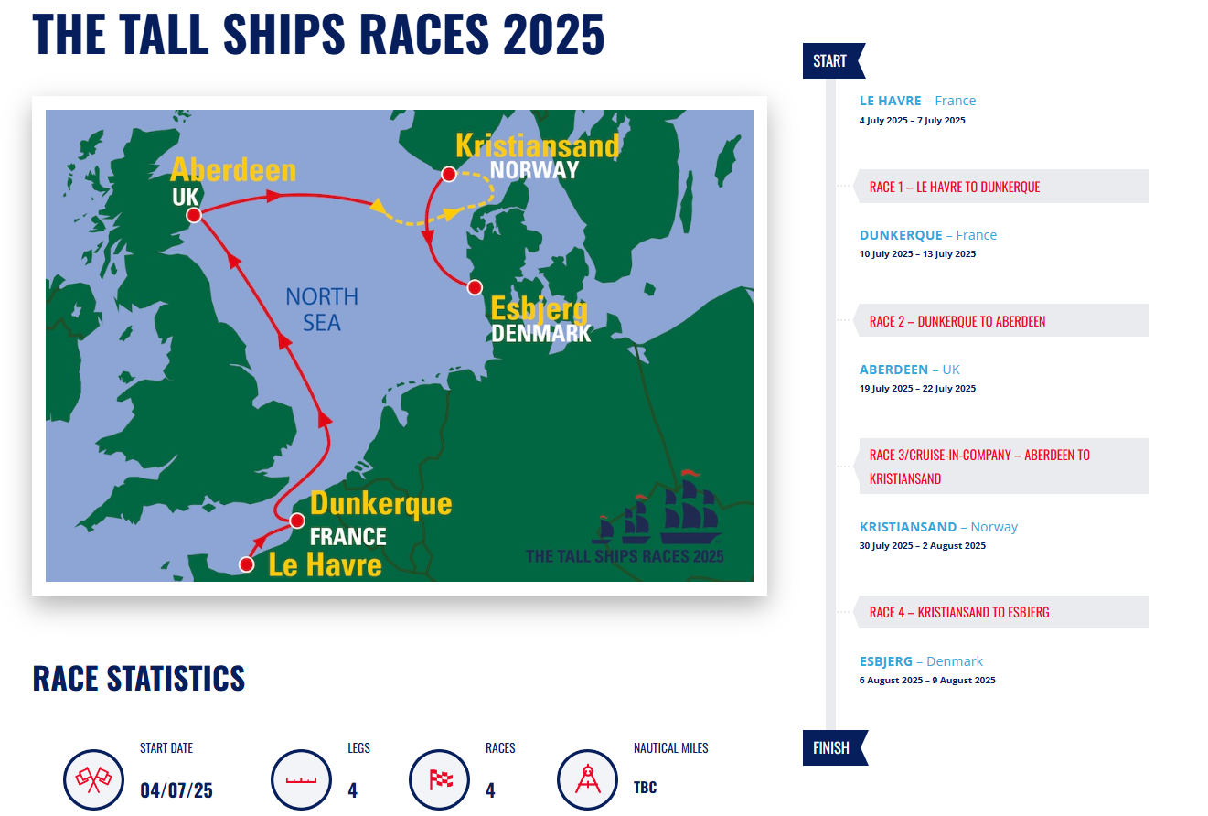

Slide 14
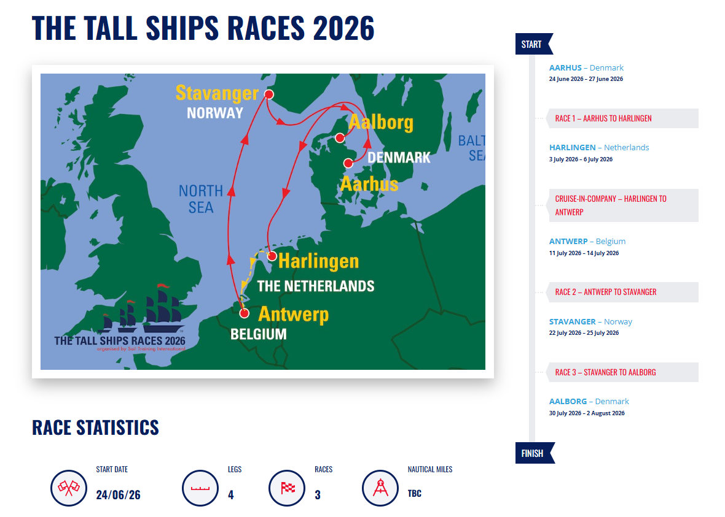

Slide 15
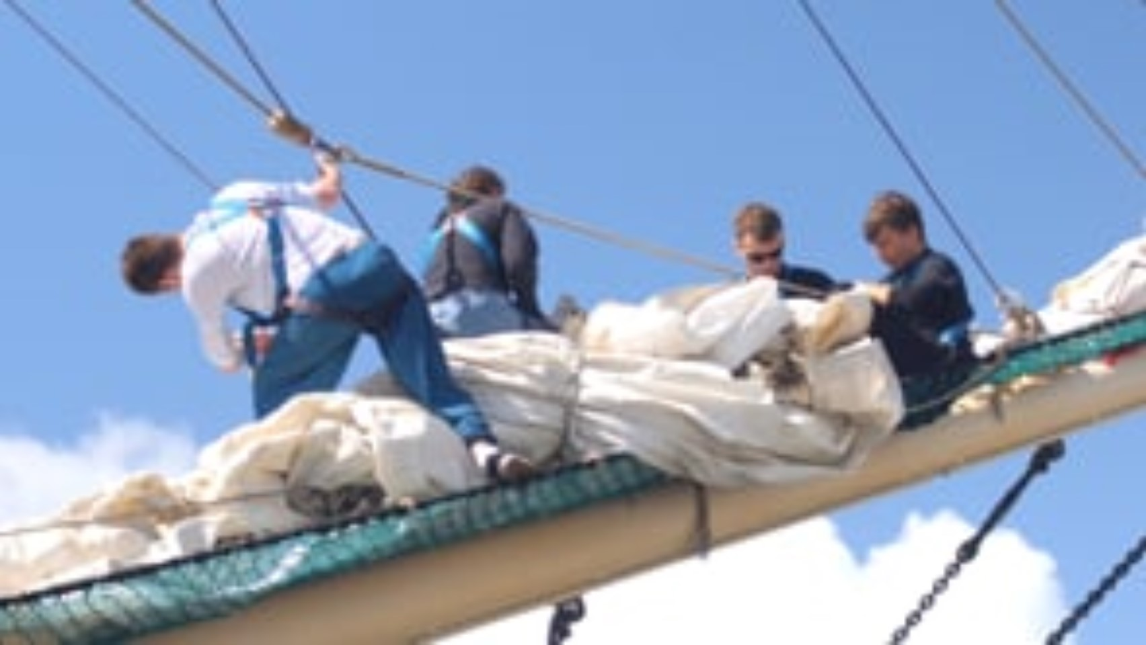

Slide 16

“Twenty years from now you will be more disappointed by the things you didn’t do than by the ones you did. So, throw off the bowlines. Sail away from the safe harbour. Catch the trade winds in your sails.”
EXPLORE. DREAM. DISCOVER

Slide 17
WANT TO SAIL WITH US?
Here’s what you need to consider…….
WHEN and WHERE – When would you like to go and where would you like to sail? A full list of voyages and dates can be found on the Sail Training International website.
WHICH VESSEL – There are different experiences and benefits to be had when sailing on different size vessels
DURATION – Voyages vary and typically last anywhere between 3-10 days.
FUNDING OPTIONS
Bursaries - For those of you who are unable to fund a voyage yourselves, there are various bursary schemes available to provide financial support.
Self-funded - Alternatively, there are many ways in which you can raise the funds you need to take part in the Tall Ships Races and Regattas. We can help guide you through the fundraising process and of course help with ideas.

Slide 18


Contact us
Our team at Sail Training International will offer advice and guidance to help you plan your sailing adventure.
www.sailtraininginternational.org
Rebecca.Nelson@sailtraininginternational.org
Sail Training International
tallshipsraces

Slide 19
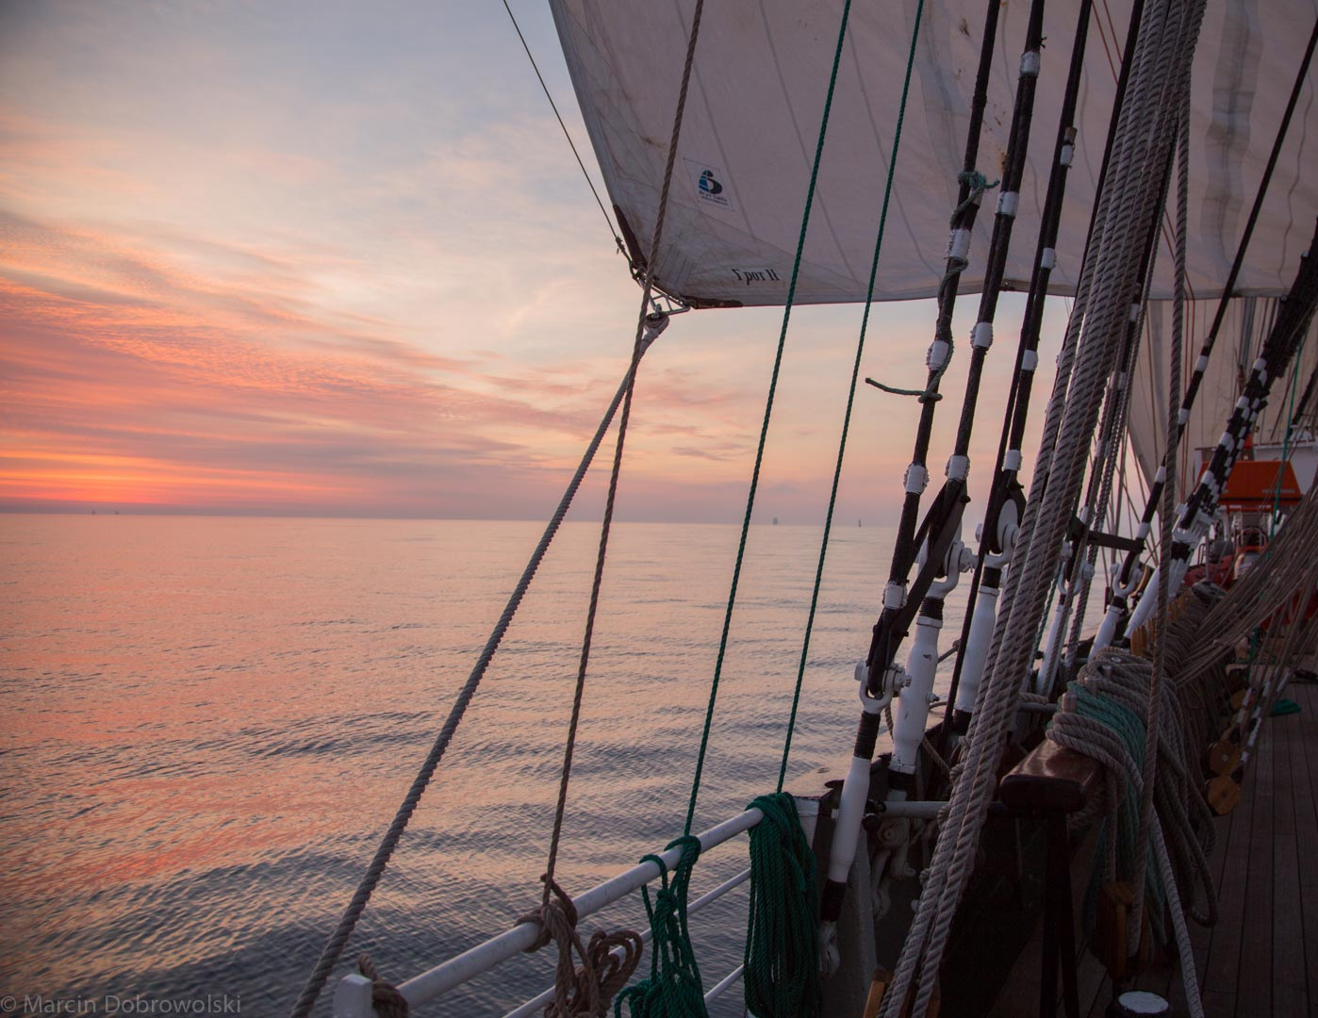



QUESTIONS?

